Slide 1
Function

Slide 2
Function
Functions are ABSTRACT

Slide 3
ABSTRACTION
WHAT
NOT
HOW

Slide 4
WHAT
NOT
HOW

Slide 5
WHAT
NOT
HOW
IMPLEMENTATION

Slide 6
Function
Functions simplify CODE

Slide 7


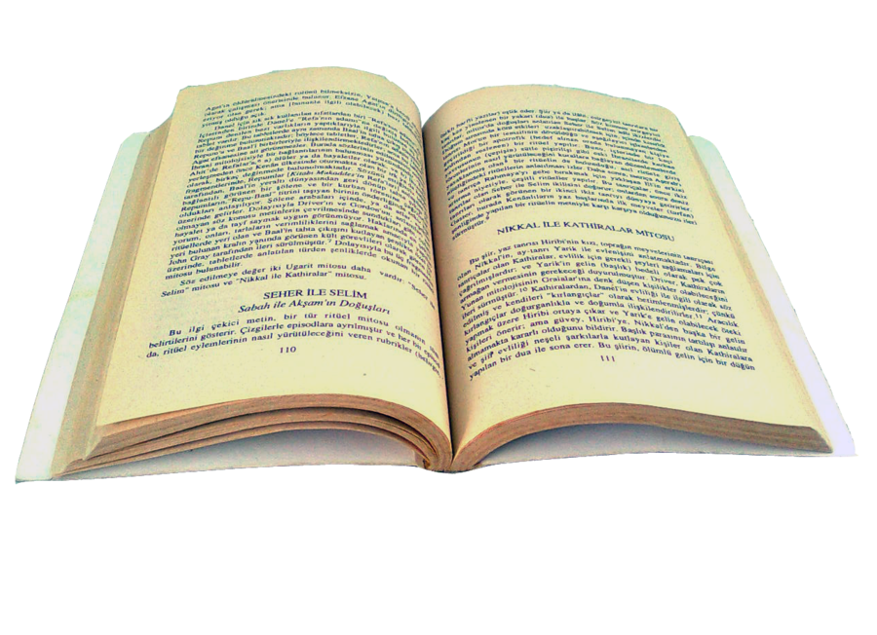
Research

Slide 8
Research

Slide 9
Research
Grab a book.

Slide 10
Research
Read the book.

Slide 11
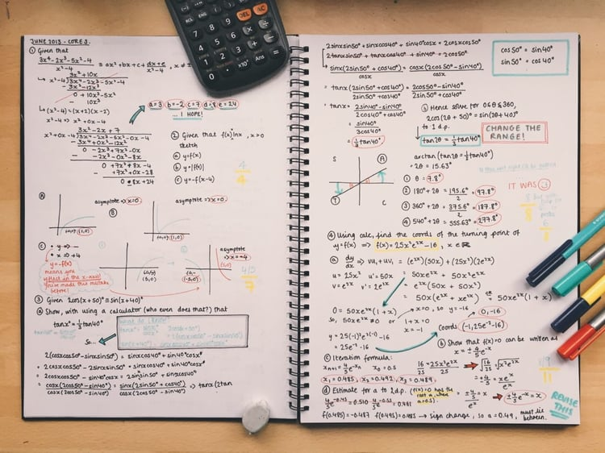
Research
Write notes.

Slide 12
Research
Grow your knowledge.

Slide 13

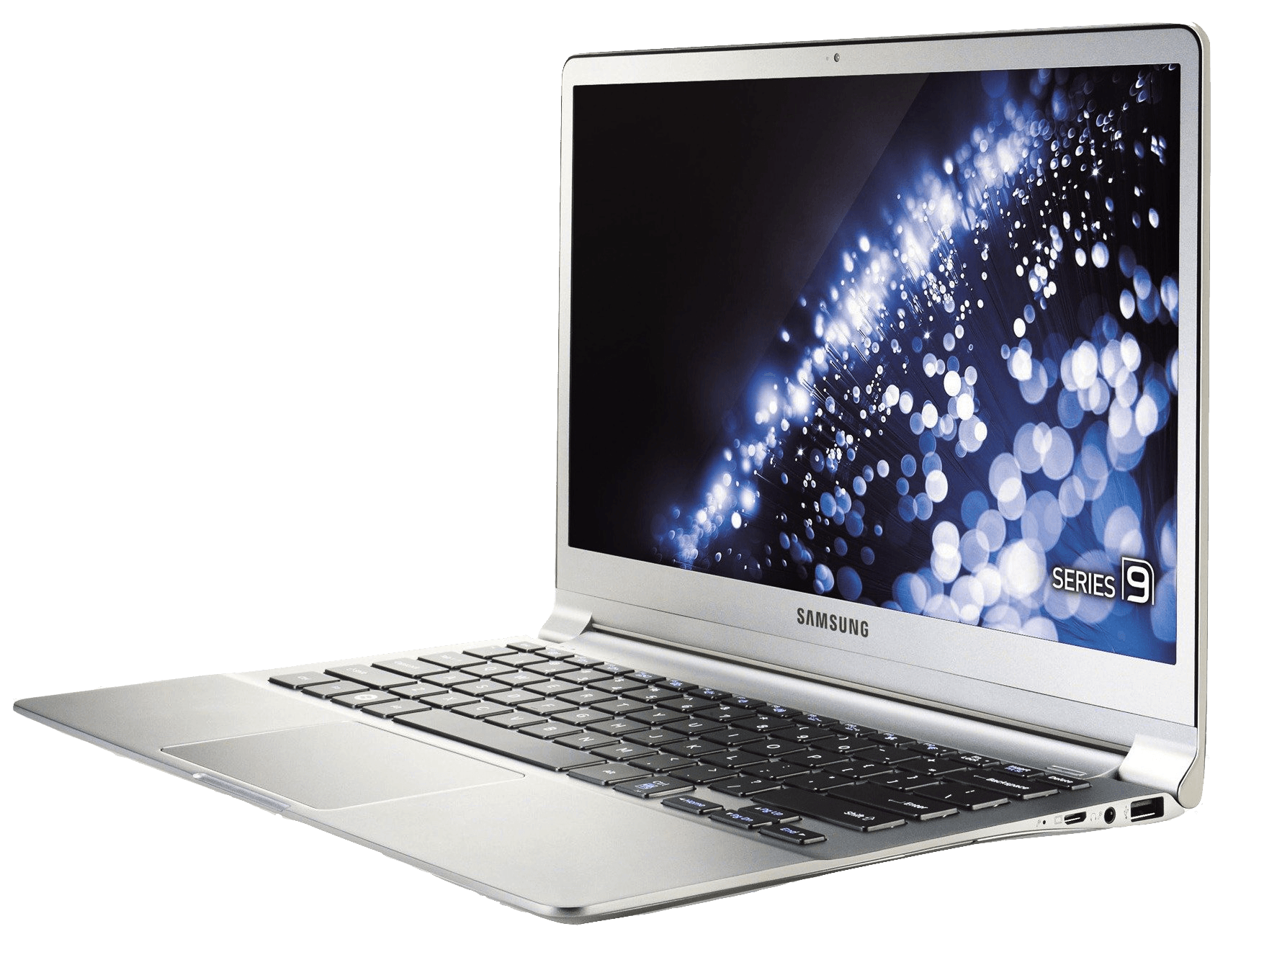
Research

Slide 14
Research

Slide 15
Research
Turn on your P.C

Slide 16


Research
Search for information.

Slide 17
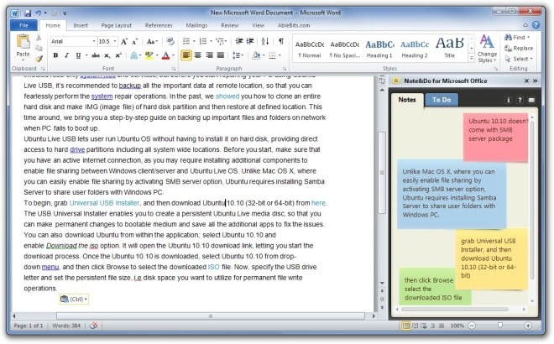
Research
Write notes.

Slide 18
Research
Grow your knowledge.

Slide 19
Different Procedures
Research
Same end result.

Slide 20
Research
Different Procedures
Same end result.

Slide 21
Research
Different
methods.
Same end result.

Slide 22
Function
Functions are just a representation on WHAT the program should do.

Slide 23
Function
If a teacher asked a student to do research.

Slide 24
Function
They wouldn’t care HOW they did research.

Slide 25
Function
Only that they DID do research.

Slide 26
Function
It would be tedious to constantly tell someone how to research.

Slide 27
Function
So we teach them
research means.
WHAT

Slide 28
Function
WHAT

Slide 29
Function
WHAT
Function Signature

Slide 30
Function Signature
WHAT
Defines an ABSTRACTION.

Slide 31
Function Signature
WHAT
Function name.
What the Function needs.
What to expect.

Slide 32
Function name.
What the Function needs.
What to expect.
Function Signature
WHAT

Slide 33
Function name.
What the Function needs.
What to expect.
Function Signature
WHAT

Slide 34
Function Signature
WHAT
Function name.
What the Function needs.
What to expect.

Slide 35
Function Signature
WHAT
Function name

Slide 36
Function name
WHAT
Name that defines what our Function does.

Slide 37
Function name
WHAT
Same naming rules as variable.

Slide 38
Function name
WHAT
Sum

Slide 39
Function Signature
WHAT
Function name.
What the Function needs.
What to expect.

Slide 40
Function name.
What the Function needs.
What to expect.
Function Signature
WHAT

Slide 41
Function Signature
WHAT
What the Function needs.

Slide 42
What the Function needs.
WHAT
Inputs for our Function.

Slide 43
What the Function needs.
WHAT
For example,
To create a Function that adds 2 numbers, it will need 2 inputs.

Slide 44
What the Function needs.
WHAT
Inputs can be constant values or variables.

Slide 45
What the Function needs.
WHAT
X
Y
Sum

Slide 46
What the Function needs.
WHAT
Function input can be other Function output.
IF the Function RETURNS
the same datatype.
(More on that later)

Slide 47
What the Function needs.
WHAT
X
Y
Sum
Z
Sum

Slide 48
What the Function needs.
WHAT
Sometimes it might not need any input.
(Very common in game development.)

Slide 49
What the Function needs.
WHAT
Like a Function that just fires a gun.
It doesn’t need an input. It will always do its own thing.

Slide 50

What the Function needs.
WHAT

Slide 51
Function name.
What the Function needs.
What to expect.
Function Signature
WHAT

Slide 52
Function name.
What the Function needs.
What to expect.
Function Signature
WHAT

Slide 53
Function Signature
WHAT
What to expect.

Slide 54
What to expect.
WHAT
Functions should do some process.
We don’t care how it’s done.

Slide 55
What to expect.
WHAT
But sometimes, we would like to expect some results.
Functions could also RETURN a value

Slide 56
What to expect.
WHAT
When we use our Sum Function, we expect it to give back the result of the sum.
That is called a returned value.

Slide 57
What to expect.
WHAT
It’s what we EXPECT

Slide 58
What to expect.
WHAT
10
20
30
30
Sum
Sum
60

Slide 59
Function
WHAT
Function Signature

Slide 60
Function Signature
WHAT
C#

Slide 61
Function Signature C#
WHAT
Function signatures are split into the 3 parts we talked about earlier.

Slide 62
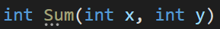
Function Signature C#
WHAT

Slide 63
Function Signature C#
WHAT
Function Name

Slide 64
Function Name
WHAT
Functions can be named exactly like variables.

Slide 65
Function Name
WHAT
There could be multiple functions with the same name
(More on that later)

Slide 66
Function Name
WHAT
But every function should have a UNIQUE Signature.

Slide 67
Function Signature C#
WHAT
Function Name

Slide 68
Function Signature C#
WHAT
Function Return Type

Slide 69
Function Return Type
WHAT
Functions can either return a value or not return anything.

Slide 70
Function Return Type
WHAT
When you specify a return type,
It means that this function will return a value of that type.

Slide 71
Function Return Type
WHAT
In the previous example we have defined the return type as int. So we expect an integer when we use our function.

Slide 72
Function Signature C#
WHAT
Function Return Type

Slide 73
Function Signature C#
WHAT
Function Input

Slide 74
Function Signature C#
WHAT
Parameters

Slide 75
Parameters
WHAT
Functions may have parameters.

Slide 76
Parameters
WHAT
Parameters are basically variables.

Slide 77
Parameters
WHAT
Each function has it’s own scope.

Slide 78
Parameters
WHAT
Each function is a program of it’s own.

Slide 79
Parameters
WHAT
It can only have local variables.
So the only way to allow external communication…

Slide 80
Parameters
WHAT
Is through parameters.

Slide 81
Parameters
WHAT
In our Sum example,
We expect that we need 2 numbers to add together.

Slide 82
Parameters
WHAT
We can’t assume that the function knows what numbers it should add.

Slide 83
Parameters
WHAT
Parameters are defined exactly like variables.
They are declared inside a “Parameter List”

Slide 84
Parameters
WHAT
They have a datatype, a name and could also be initialized!
(More on that later)

Slide 85
Parameters
WHAT
There can be an infinite number of parameters (Or none!)

Slide 86
Function Signature C#
WHAT

Slide 87
Function Signature C#
WHAT
What if you had more than just 2 numbers?

Slide 88
Function Signature C#
WHAT
You could add a parameter for each additional number

Slide 89
Function Signature C#
WHAT
But that would break functionality.

Slide 90
Function Signature C#
WHAT

Slide 91
Function Signature C#
WHAT
Now we are forced to only have
FOUR parameters.
We cant sum only 2 numbers, we are forced to sum 4 instead.

Slide 92
Function Signature C#
WHAT
How to fix?

Slide 93
Function Signature C#
WHAT
params keyword

Slide 94
Function Signature C#
WHAT
Instead of having to add multiple parameters, we can instead take in an array of inputs!

Slide 95
Function Signature C#
WHAT
An array will allow us to enter as many numbers as we would like.

Slide 96
Function Signature C#
WHAT
Using the params keyword,
It allows us to pass in multiple data however we like.

Slide 97
Function Signature C#
WHAT
Params keyword means that we have an infinite number of parameters of a specific type.

Slide 98
Function Signature C#
WHAT
There is no limit.

Slide 99
Function Signature C#
WHAT
There is a small thing to consider.

Slide 100
Function Signature C#
WHAT
params SHOULD always be the very last input.
Here it throws an error.

Slide 101
Function Signature C#
WHAT
Valid case:

Slide 102
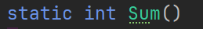
Function Signature C#
WHAT
Functions could have 0 parameters by simply not adding any.
Parameterless

Slide 103
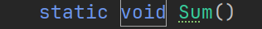

Function Signature C#
WHAT
Functions could also have no output or return type using the void datatype.

Slide 104
Function Signature C#
WHAT
Void is a datatype that simply means nothing.
It’s only used as a return type for functions.
Indicating that it returns nothing, no output.

Slide 105
Function Signature C#
WHAT
Functions with void return type or no parameters are always IMPURE functions
(More on that later)

Slide 106
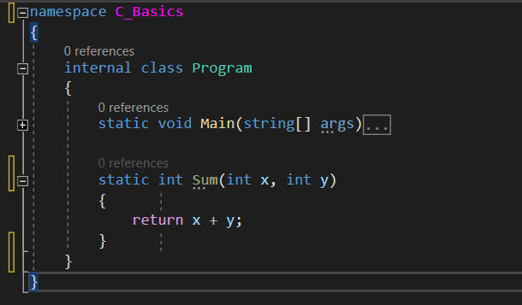
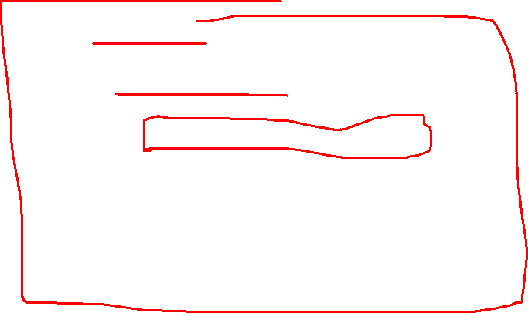
Defining A Function
WHAT

Slide 107
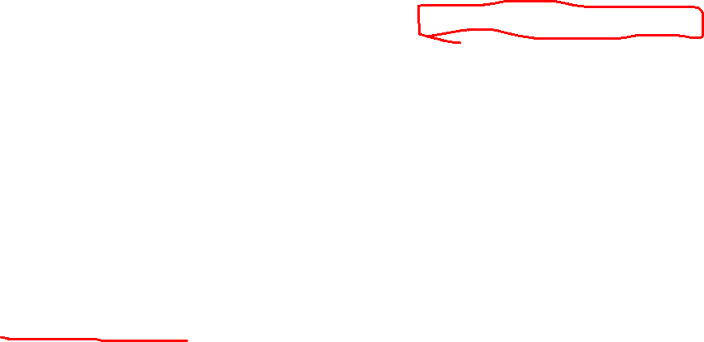
Defining A Function
WHAT
Functions can ONLY be defined inside of classes In C#.
We don’t yet know what a class is, but for now just assume that it can only be defined inside of this Program scope.
(There are other ways but it’s too advanced so we will talk about them later.
You could search them up if you are curious!
(Local Functions))

Slide 108
Defining A Function
WHAT
Functions can only be defined with a static prefix.
(We will learn what static means later on in O.O.P)

Slide 109
Defining A Function
WHAT
Just like the main function that we write our code in

Slide 110
Defining A Function
WHAT
Functions are also scopes so they have a body to implement your code in.
HOW

Slide 111
Function
HOW

Slide 112
Implementing Function
HOW
Void Functions

Slide 113
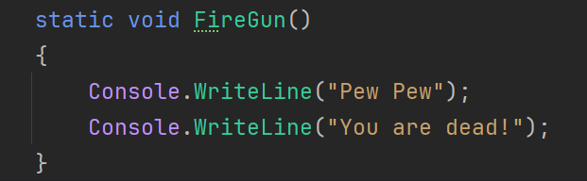
Implementing Function
HOW
You can write basically any code inside of a function.
For example this is a function that just prints some stuff.

Slide 114
Implementing Function
HOW
Now FireGun()
Means to print pew pew and you are dead.
But how do we use that function in our code?

Slide 115
Implementing Function
HOW
Function Calling

Slide 116
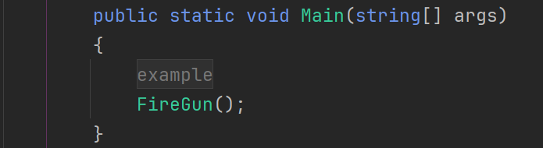
Implementing Function
HOW
You just simply write the function name and pass in values to the parameters if it has any.

Slide 117
Implementing Function
HOW
This is literally just equivalent.

Slide 118
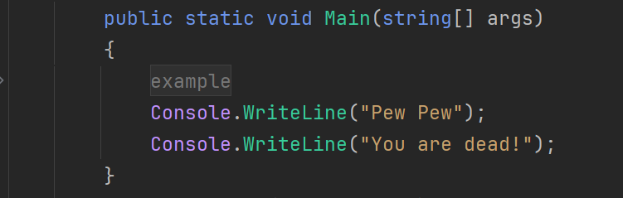

Implementing Function
HOW
To this.
(In reality there is a difference between this and a function call which might not be explained here. But I recommend you search it up!
Search up what’s known as the call stack and how functions are called)

Slide 119
Implementing Function
HOW
We are simplifying the code. Because we can REUSE functions without having to rewrite it’s implementation.

Slide 120
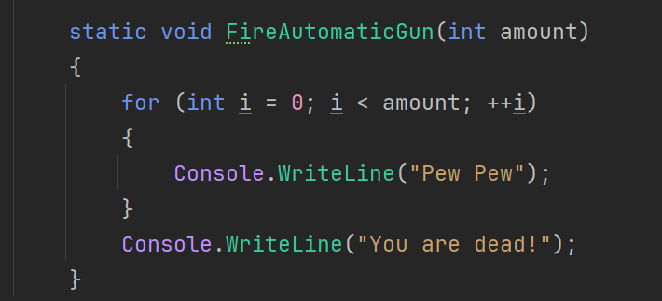
Implementing Function
HOW
Let’s have an example on parametrized void functions:

Slide 121
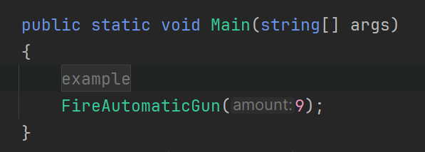
Implementing Function
HOW
Let’s have an example on parametrized void functions:

Slide 122
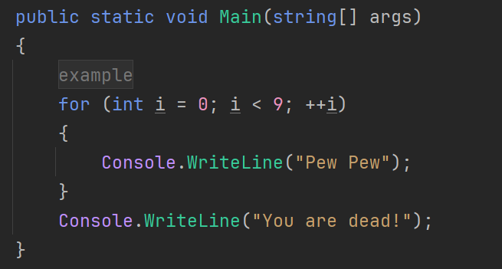
Implementing Function
HOW
Which is equivalent to:

Slide 123
Implementing Function
HOW
It’s starting to get more complex, especially if we would like to use this piece of code multiple times.

Slide 124
Implementing Function
HOW
So this is so much better than rewriting the same procedure over and over again.

Slide 125
Implementing Function
HOW
Non Void Functions.

Slide 126
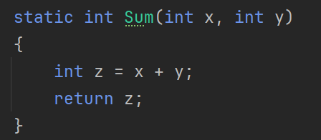
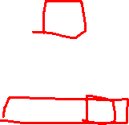
Implementing Function
HOW
Non void functions are implemented exactly like void functions. Except you MUST provide an end statement called a return statement.

Slide 127
Implementing Function
HOW
Return Keyword

Slide 128

Implementing Function
HOW
Return keyword just simply means that whoever called my function, should expect this output.
Once I execute the return statement, I will be replaced with this output.

Slide 129
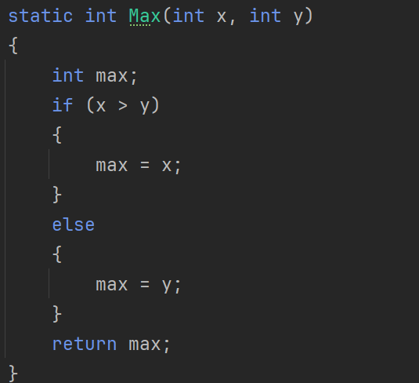
Implementing Function
HOW
Return statement will terminate the function once it reaches it.
It wont continue or run any other code after that return statement, Which can be really useful to determine when to stop instead of having to waste computation power by unnecessary steps.

Slide 130
Implementing Function
HOW
Which can simplify this function

Slide 131
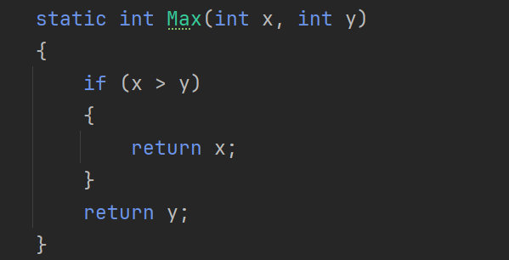
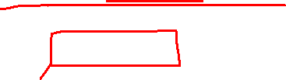
Implementing Function
HOW
To this:

Slide 132
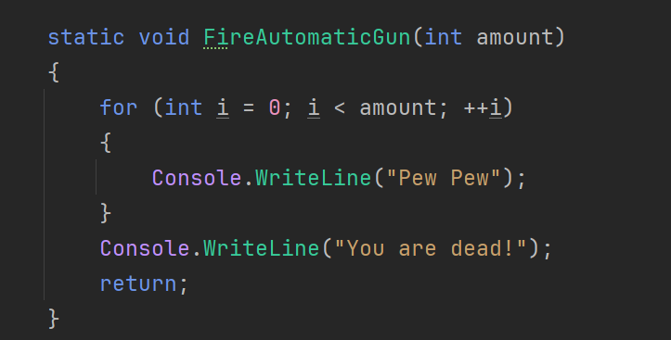
Implementing Function
HOW
Void functions can have a return statement.
But it must be an empty return statement because it cant return anything

Slide 133
Implementing Function
HOW
In this case, we are getting an output of the local variable z.
Which is just = x + y.

Slide 134
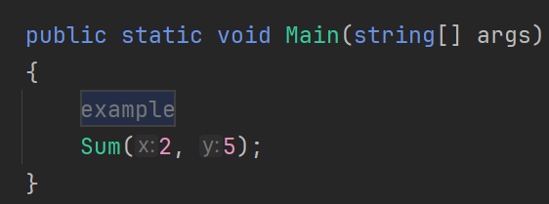
Implementing Function
HOW
Let’s demonstrate it by calling the function.

Slide 135
Implementing Function
HOW
Here this just means that we are going to be adding x and y (2 + 5)
And whatever the value is, if anyone needs it, it’s going to be 7.

Slide 136
Implementing Function
HOW
But in this case, how do we use the output we just defined?
Here the output is lost, it’s basically redundant output.

Slide 137
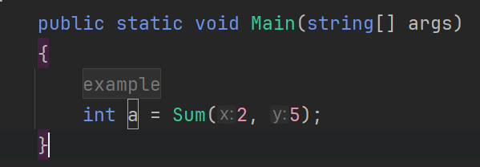
Implementing Function
HOW
We can simply just assign a variable to be equal to the result of this function.

Slide 138
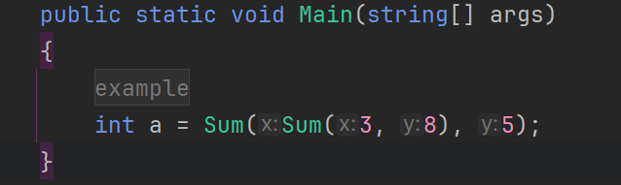

Implementing Function
HOW
We can also pass in the result of that function to another function like such:

Slide 139
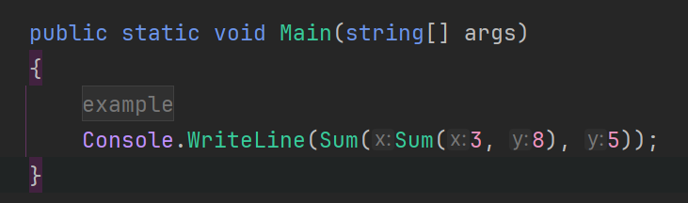
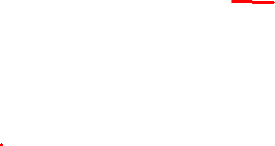
Implementing Function
HOW
Or this:

Slide 140
Implementing Function
HOW
Functions should be as simple and reusable as possible.

Slide 141
Implementing Function
HOW
Functions simplify code.
Functions allows you to reuse code.
Functions makes your code more readable and understandable.
Functions makes debugging easier and prevents future bugs.
Functions can allow you to change code very quickly.

Slide 142
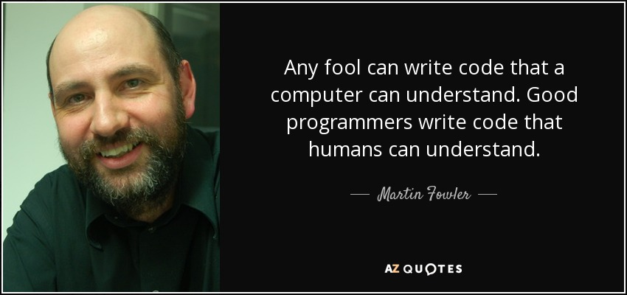
Implementing Function
HOW

Slide 143
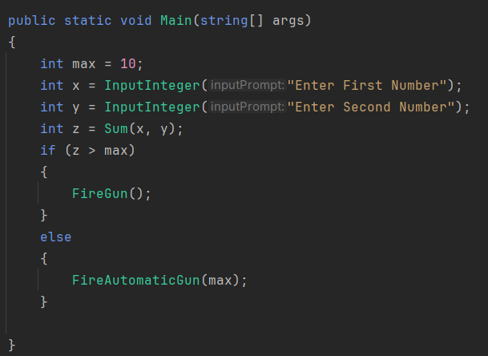
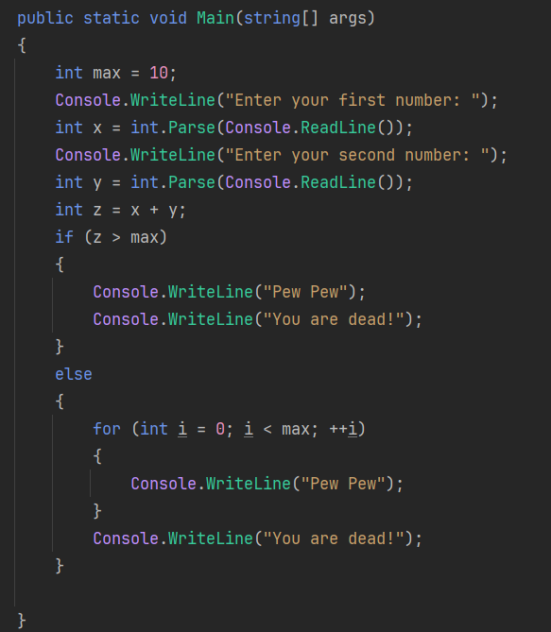
Implementing Function
HOW
Example:

Slide 144
Implementing Function
HOW
You should always try your best to write code that’s understandable.
We will learn how to write good code and split your code into simpler functions.

Slide 145
Implementing Function
HOW
Breaking down our code into functions.

Slide 146
Implementing Function
HOW
There is a really popular acronym in Software Engineering called DRY
Don’t
Repeat
Yourself.

Slide 147
Implementing Function
HOW
If you ever find yourself copy pasting code, you are doing something wrong.
If you are copy pasting code, this means that you can probably write a function that allows you to reuse it instead.

Slide 148
Implementing Function
HOW
Example:

Slide 149

Implementing Function
HOW
Example:
First things first, this code looks horrible.
It’s hard to understand what it means from the first look.

Slide 150
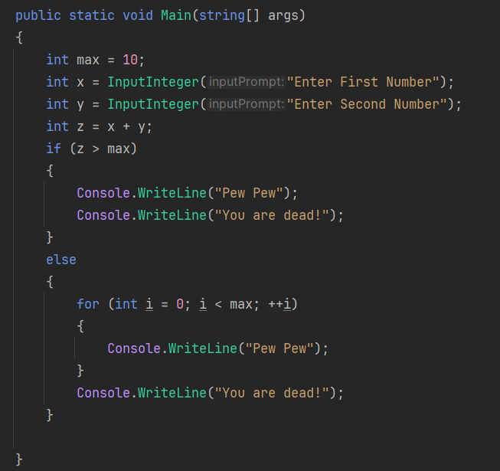
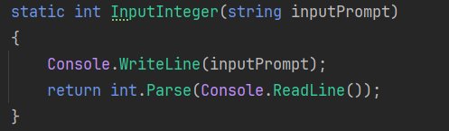
Implementing Function
HOW
First of all, we are rewriting the same input logic,
So let’s abstract that into it’s own function.

Slide 151
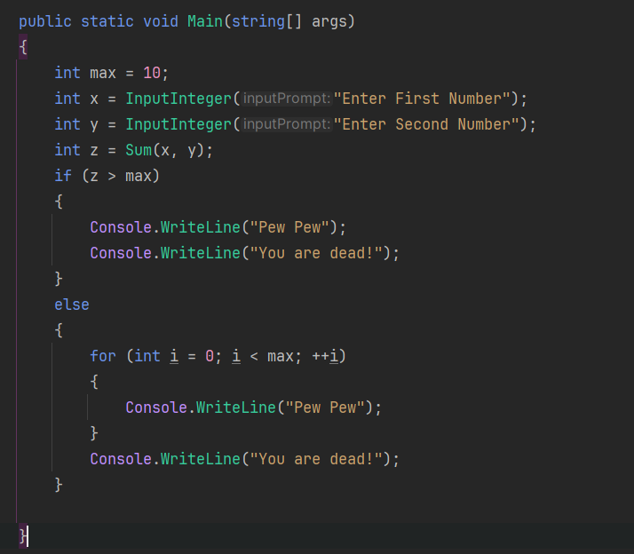
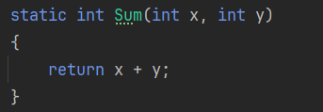
Implementing Function
HOW
It would be better to have a function that can handle the sum process too.
(Not necessary but can help with readability)

Slide 152
Implementing Function
HOW
Z > max doesn’t have to turn into a function, you could but it’s gonna be redundant.
Sum is important because you might want to add more logic, but here there is no additional logic to add.

Slide 153
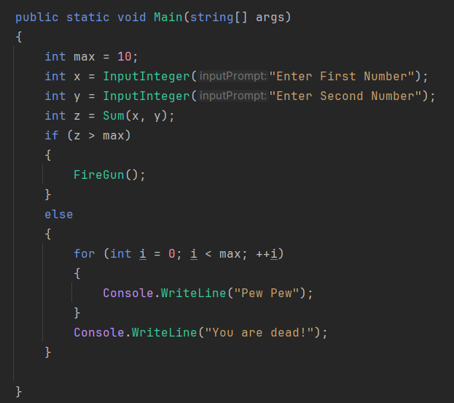
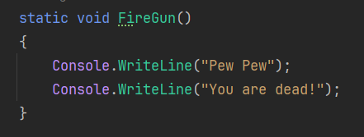
Implementing Function
HOW
We could turn the pew pew you are dead into a FireGun method too like before.

Slide 154
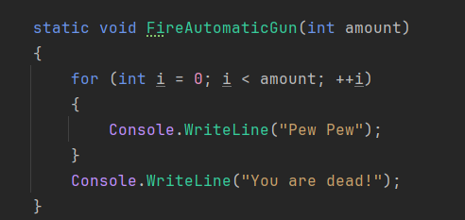
Implementing Function
HOW
We could also turn the one below it into the automatic weapon.

Slide 155
Function
Function
Purity

Slide 156
Function
Functions can either be PURE
Or IMPURE

Slide 157
Function
Pure Function

Slide 158
Pure Function
A pure function is a function that is consistent.
A function that ONLY relies on it’s inputs and produces consistent outputs.
Will produce the same output if given the same input.
Completely deterministic.

Slide 159
Pure Function
Function
Input
Output

Slide 160
Pure Function
Sum
5
14
9

Slide 161
Pure Function
Pure functions makes it hard to write bad, buggy code.
And is very easy to debug, read and understand!
Pure functions are also very easy to test.

Slide 162
Pure Function
Examples on Pure Functions:
Any sort of mathematical function.
(Sum, Multiply, Divide, etc)

Slide 163
Function
Impure Function

Slide 164
Impure Function
Impure functions don’t have consistent outputs.
They always contain what’s known as
Side-Effects

Slide 165
Impure Function
Side-Effects
Side Effects are unexpected behaviors.
We expect a function to take in an input and return an output.
If it does anything extra, it’s considered a side effect.
Examples include:
Printing to console.
Reading input.

Slide 166
Impure Function
Side-Effects
Impure functions are common in game development.
They are, generally, VERY common in O.O.P

Slide 167
Impure Function
Sum
5
14
9
“My sum is 14”

Slide 168
Impure Function
Impure functions makes it harder to debug code.
More prone to error.
Can produce unexpected results.
Harder to test.

Slide 169
Function
Function Overloading

Slide 170
Function Overloading
In this function, we add up two INTEGERS.
Which would be fine, but what if we wanted to add float numbers?
We can’t just pass in a float for x and y.
It would give us an error.

Slide 171
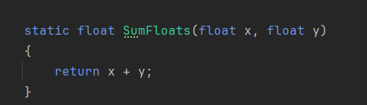
Function Overloading
We instead will have to create a separate function for floats.

Slide 172
Function Overloading
Which is fine this way, but there is also a cleaner and more concise way to do it.

Slide 173
Function Overloading
Remember when we said functions can have the same name? But unique signatures?

Slide 174
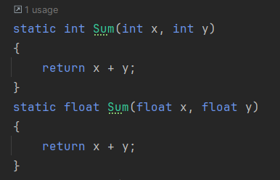
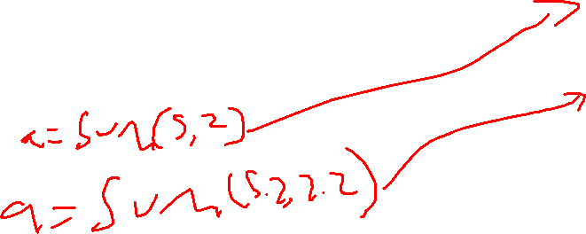
Function Overloading
This is exactly what it means to have function overloading

Slide 175
Function Overloading
These 2 functions have the same name but different unique signatures.

Slide 176
Function Overloading
The compiler will know that if we pass in 2 ints, it will sum up 2 ints, and if we pass in 2 floats, it will sum up 2 floats.

Slide 177
Function Overloading
Signatures are only unique according to their parameter list!

Slide 178
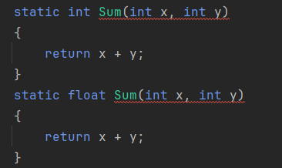
Function Overloading
Here there is no way for the compiler to know which function it should call.
You will have to pass in 2 ints in both functions.

Slide 179

Function Overloading
It can be really confusing so the compiler won’t allow you to do so.

Slide 180
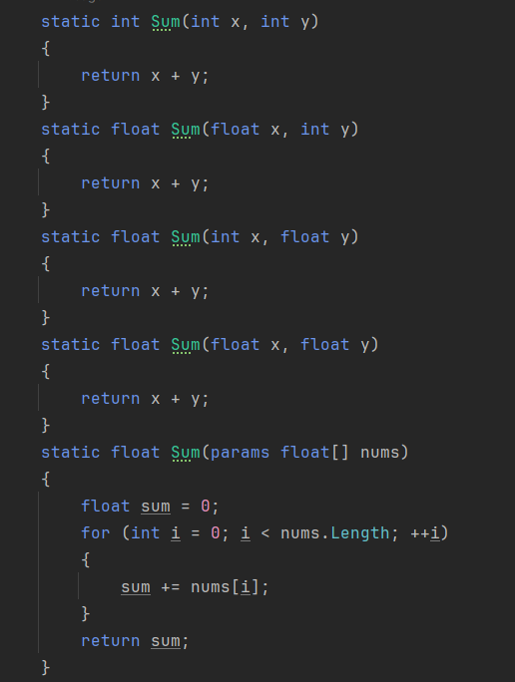
Function Overloading
Instead only parameter list needs to be unique, Parameter list are unique according to:
Number of parameters, Datatype of parameters, or Order of parameters.

Slide 181
Function
Reference Parameters

Slide 182
Reference Parameters
When you pass in a parameter, you will always pass it in as either a value type or a reference type.
(Recall from Arrays)

Slide 183
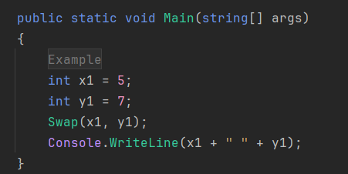
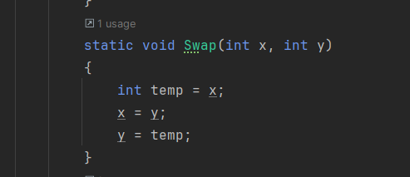
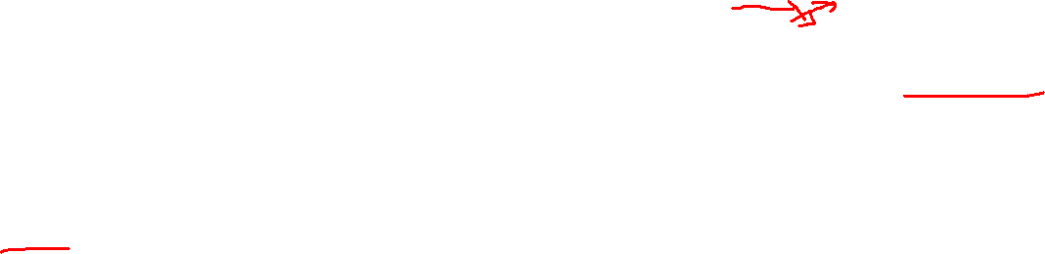
Reference Parameters
In this example,
We got 2 variables of int datatype which is a simple VALUE type.
What is the expected output of this function?
We expect that x1 and y1 values will be swapped, so we expect that it will print out 7 5.

Slide 184
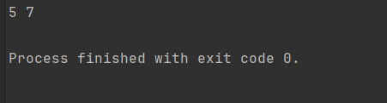
Reference Parameters
Not quite the output we were hoping for…
What happened?

Slide 185
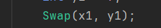
Reference Parameters
We haven’t actually swapped the variables themselves.
When we called the swap function.
We ONLY passed in values.

Slide 186
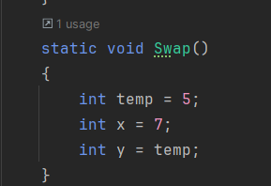
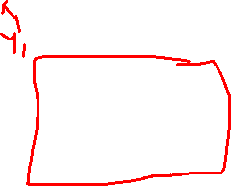
Reference Parameters
It’s equivalent to doing this:
We ONLY swapped the parameters/variables inside the function scope!

Slide 187
Reference Parameters
How do we ensure that we swap the variables x1 and y1 themselves?

Slide 188
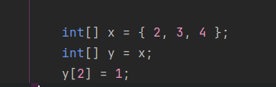
Reference Parameters
Remember how when you had 2 arrays like this.
Arrays are reference types.
So by saying that y = x, we are saying that whatever array x is referring to or the array that it OWNS.
Y also owns it and refers to it.

Slide 189





Reference Parameters
We can visualize x and y as keys to a door.
And the door as the actual array.
X

Slide 190

Reference Parameters
We then create a COPY of that key, and call it y.
X
Y

Slide 191
Reference Parameters
These 2 keys can now access the same door.
X
Y

Slide 192

Reference Parameters
Reference types are like the keys.
And the values are like the doors.
X
Y

Slide 193



Reference Parameters
x
y
X1
Y1
5
7
5
7
When we pass in a value type, we just create an entirely new door.

Slide 194
Reference Parameters
Everytime we pass in a value, we have to copy its value to another door.
But what if, Instead of copying its value to another door, we instead copy it to a key? And use that key to access those doors of x1 and y1.
So in short, we need to treat x and y as REFERENCE values.
X
X1
Y1
5
5
y

Slide 195


Reference Parameters
To treat x1 and y1 as reference values, we have to specify in the parameter list that each parameter is a reference value.

Slide 196
Reference Parameters
Here we are saying that we expect that x is a reference type of int and NOT a value type.
We expect to pass in keys and not create doors.

Slide 197

Reference Parameters
To use this, we will have to specify that whatever variable we pass in is a reference type.
So we have to write ref before the variable name

Slide 198

Reference Parameters
X
X1
Y1
5
5
y

Slide 199


Reference Parameters
It’s gonna be equivalent to this:

Slide 200
Reference Parameters
Our original variables are treated as if they’re in a bigger scope than the function itself.

Slide 201

Reference Parameters
The output will now be the following:

Slide 202
Reference Parameters
There is also another type of reference parameter.
Let’s say, you had a function and functions can only return ONE value.
What if you wanted to return more values?

Slide 203
Reference Parameters
Divide
x
Quotient
y
Remainder

Slide 204
Reference Parameters
In the previous example,
Our main returned value is the quotient.
But we also need the remainder for other operations.

Slide 205


Reference Parameters
Another type of reference parameter that can help us is the out parameter.

Slide 206
Reference Parameters
Out is basically just a ref parameter, but you MUST set a value to that parameter inside the function.

Slide 207

Reference Parameters
Here we divide x2 by y2,
We also define a variable called remainder that will be passed in as reference (out in this case)
We will take the quotient value and store in the variable quotient. And if there is a remainder it will be stored in the variable remainder.

Slide 208

Reference Parameters
Let’s check the output of both values:

Slide 209

Reference Parameters
Seems right!
We have basically returned 2 values (Indirectly)

Slide 210

Reference Parameters
NOTES:
Arrays are by default reference type and any other reference types will always be passed in as reference parameter.
You don’t need to specify that they are ref.

Slide 211



Reference Parameters
X
TwoNums

Slide 212

Reference Parameters
BUT.
If you want to swap TWO ARRAYS or REFERENCE TYPES.
Basically if you want to create an entirely new array and have the array parameter be a key to that new door (array)
You must specify that it’s a ref type!

Slide 213
Reference Parameters
X
TwoNums

Slide 214

Reference Parameters
X
TwoNums

Slide 215

Reference Parameters

Slide 216
Reference Parameters
X
TwoNums

Slide 217
Reference Parameters
X
TwoNums

Slide 218
Reference Parameters
X
TwoNums

